Slide 1
End User Modelling

Slide 2
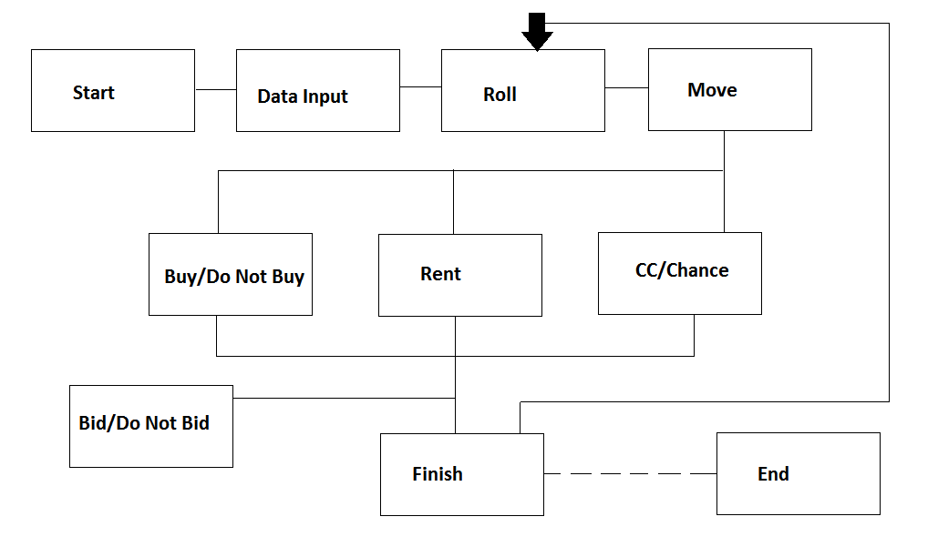
Design

Slide 3
Design
Functionalities converted to classes
Each class will have…
Input
Process
Output
Organized & Cross-compatible approach

Slide 4
Code Generation
Relevant classes split in modules
Once basic functionalities are complete…
Create GUI
User forms, scroll bars, buttons, etc.
Documentation and non-essential features

Slide 5
Testing
Begin at the conceptual level
Each class will be tested individually
Use extreme cases
Approach will allow minimal error
Test from the perspective of user

